Slide 1
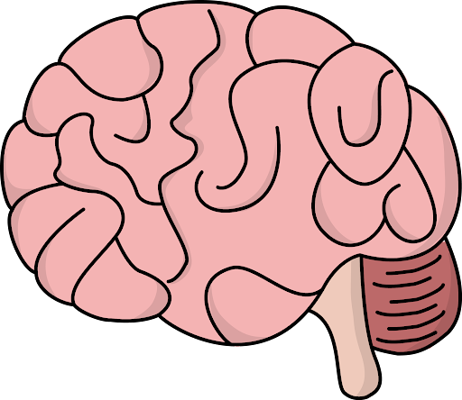

Brain tumor classification: an analysis on the importance of feature extraction in deep learning

Slide 2
Introduction
Overarching Problem
Overarching Solution
Related Work
Brain tumors kill 18,600 people in the US every year
If we can identify tumors early we can better treat those people
Feature Extraction
Experiments
Results
Traditional Method
New Method
Radiologists analyze MRI scans of the brain and identify the tumor type
We use techniques from computer vision and deep learning to identify the tumor type
Conclusion

Slide 3
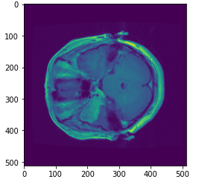
Overview of the Dataset
Introduction
Brain Tumor Classification Dataset
3 classes: meningioma, glioma, and pituitary tumors
(512, 512) MRI scans (measure the water content in the brain)
708 Meningioma samples
1426 Glioma samples
930 Pituitary samples
Related Work
Feature Extraction
Experiments
Results
Conclusion

Slide 4
Introduction
Specific Problem
Specific Solution
Related Work
We can’t always rely on having large datasets of tumor samples
Find the balance between computer learned features and manually extracted features dependent on the size of dataset
Feature Extraction
Experiments
Our Hypothesis
Results
Conclusion
The less samples used in training, the more important hand-crafted features become for deep learning models

Slide 5
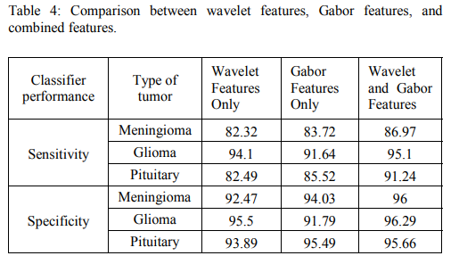
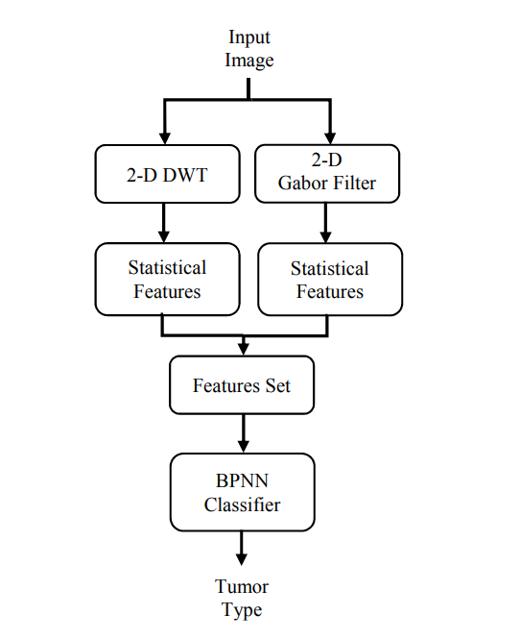
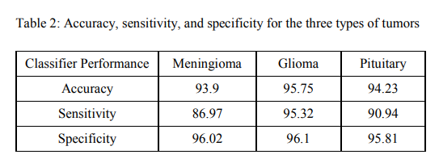
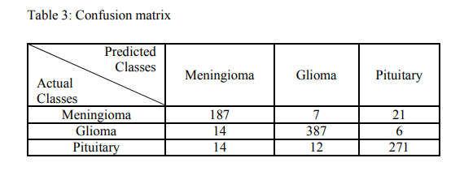
Introduction
Ismael, M. R., and Abdel-Qader, I. 2018
Related Work
Feature Extraction
Experiments
Results
Conclusion

Slide 6
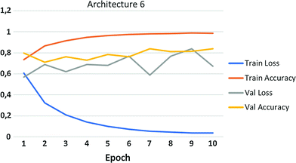
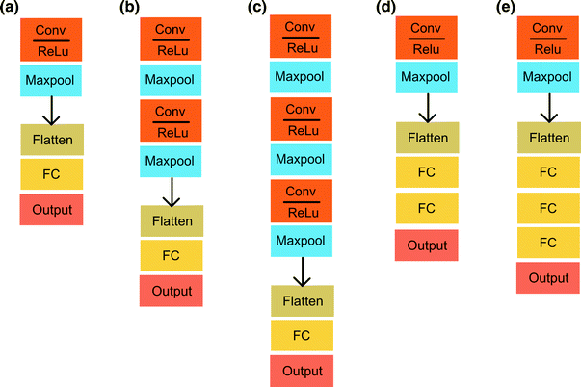
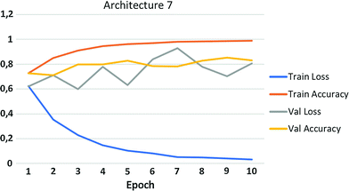
Introduction
Abiwinanda et al. (2019)
Related Work
Feature Extraction
Experiments
Results
Conclusion

Slide 7
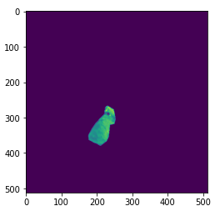
Vanilla Mask
Introduction
Original brain image
Pipeline
Related Work
Loads Image: Takes the original mat file for the brain and reads it as an np array.
Vanilla Mask: Takes the image’s np array and gets rid of all the pixels in the array that are not considered a part of the mask in the array.
Feature Extraction
Experiments
Vanilla masked image
Results
Conclusion

Slide 8
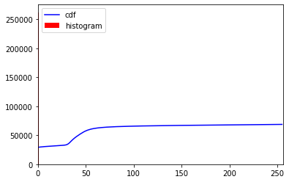
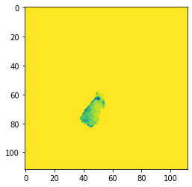
One Histogram Equalizer
Introduction
Pipeline
Related Work
Gaussian Filter: Smoothing operator to blur the original image. The main purpose is to get rid of the ‘noise’ in the image.
Feature Extraction
Histogram Equalization: Image processing technique to adjust the contrast of the image. This step helps bring out the color of the tumor.
Experiments
Results
Apply the Mask: Get rid of all pixels in the original brain image that are not the tumor, keeping just the tumor.
Conclusion
Resize to (112, 112, 1):

Slide 9
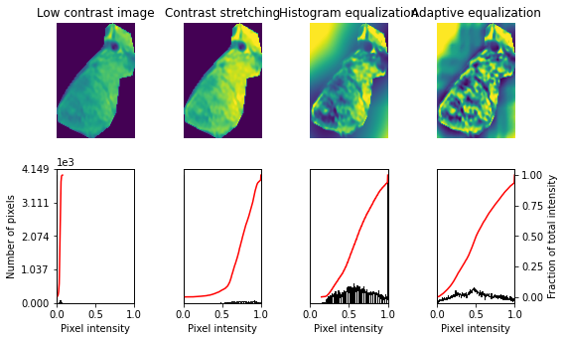
Multiple Histogram Equalizers
Introduction
Pipeline
1. ROI Segmentation: Crops the image to be the region where the tumor is
Related Work
2. Contrast Stretching: Rescales image to include all intensities that fall between the 2nd and 98th percentiles.
Feature Extraction
Experiments
3. Local Equalization: Enhances images with low contrast by spreading out the most frequent intensity values in an image, emphasizing local gray level variations.
Results
Conclusion
4. Adaptive Equalization: A version of histogram equalization that computes multiple histograms corresponding to distinct sections of the image.
1.
2.
3.
4.

Slide 10
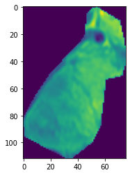
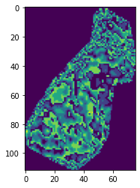
Statistical Feature Extraction
Introduction
Related Work
Pipeline
[2.5627462 ]
[3. ]
[1.14661151]]
1. ROI Segmentation: Crops the image to be the region where the tumor is
Feature Extraction
2. Normalization: Set all the pixel values in the range [0, 1]
Experiments
1.
2.
3.
4.
3. Adjust contrast: Linear transformation that stretches the values of the pixels by amplifying the intensity of the most common pixel values
Results
Conclusion
4. Extract Statistical Features: Takes the mean, median, std deviation of the pixel values

Slide 11
Introduction
Experimental Design
Evaluate on different percentages of the dataset: Make a sub-dataset of varying percentages to evaluate how well the model does as the size of the dataset grows
Related Work
Overview of the Experiments
Feature Extraction
Methods in increasing reliance on extraction
Vanilla Crop
One Histogram Filter
Multiple Histogram Filters
Statistical Features
Percentage of the Dataset Used
20%
40%
60%
80%
100%
Experiments
5-Fold Cross Validation: For each For each sub-dataset we split into 5 pieces the first four for training and the last for testing
Results
Conclusion
Epochs and Callbacks: Run for 1000 epochs or until the validation loss hasn’t decreased in 50 epochs

Slide 12
Introduction
Experimental Design
CNN: Used for Vanilla Mask, Histogram Equalizers
Conv2d Layer: Slides a filter over the image creating a feature map of the image
Max Pooling Layer: Downsamples the image, creating more general features
Dropout layer: Hides weights to make the model more robust
Linear Regression: This will be used for the statistical feature extraction
Finds the line of best fit through the feature vectors (mean, median, std)
Related Work
Feature Extraction
Experiments
Results
Conclusion

Slide 13
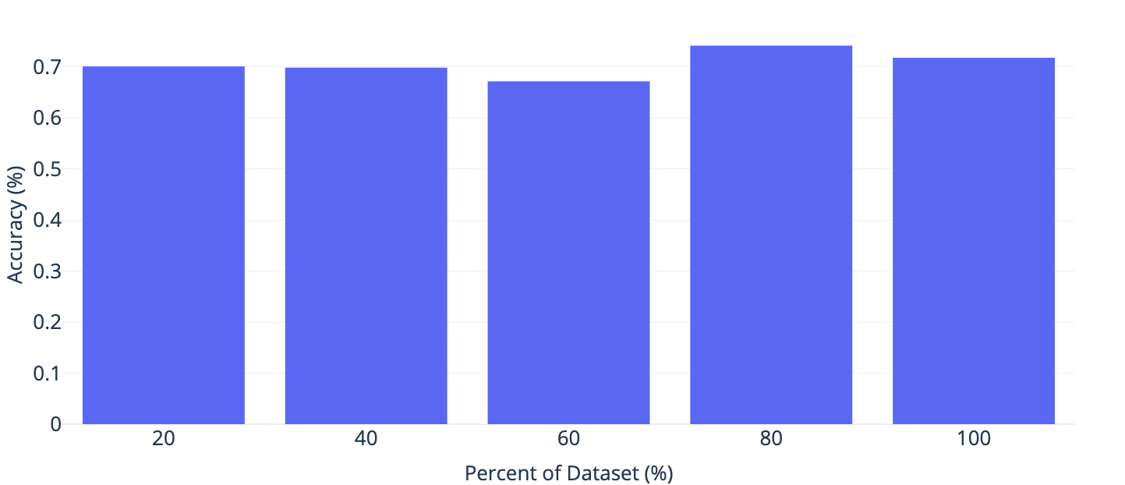
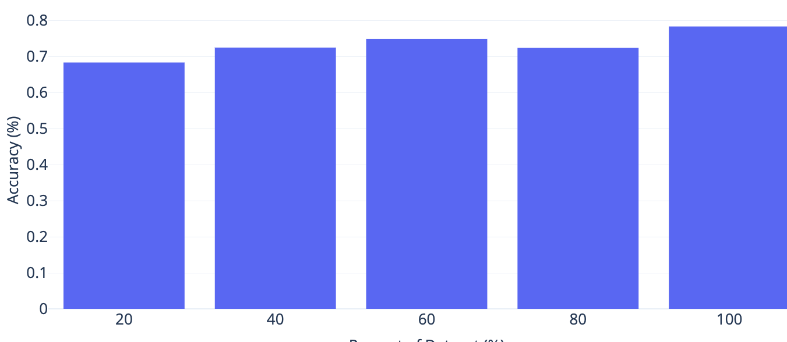
Introduction
Vanilla Mask
Related Work
Feature Extraction
Experiments
Results
One Histogram Equalizer
Conclusion

